Slide 1
TRUSTNET
LINKING SERVICE PROVIDERS FROM YOUR TRUSTED NETWORK

Slide 2

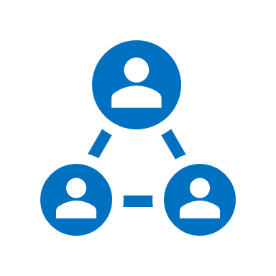


Story
Electricity rate increase
Asked friends
Get solar installed
research
Contact
quotes
ROI
1 year
1 week
Solar Installed!
Tradie thinks maybe waste of time called does not trust the tradie
Call out fees

Slide 3
Story
I did not bargain or waste time; just asked to fix the issue because I trusted this plumber due to recommendation
Plumber knew it won’t be a waste of time because of recommendation. Trust!
Asked friends;
Couple of friends gave the same contact living in nearby suburb
One plumber asked for call out fee; they might not be sure how serious I am
Plumber dropped by early morning before going to his other job; he was happy to know he was recommended
Plumber
Called;
Messaged;
Submitted forms
Leakage in Laundry
Builder rejects
To look at
Search online
2 months
Plumbing issue confirmed to be builder's issue
1 week
Tradie thinks maybe waste of time called does not trust the tradie
Call out fees

Slide 4



Problem
Is this a problem universal? Or how big is the problem?
Interviewed – 30 people
90% face on going challenges
More than 60% tap into their family and friends’ network
Xx% Tradies perceive commitment from buyer when they are directly contacted with recommendation
Xx% Online queries are perceived to be less serious, than direct contact (conversion rate???)
Keeping up with the Ratings is stressful

Slide 5


Modes of communication
Call or message people - how many people can we call? Limited bandwidth
- hit and miss (??) - time consuming and delayed
Dunbar’s number – 150 connections
Post on Whatsapp groups - hesitant to post in bigger groups
- impacts the positive image of the person; (don’t want to broadcast issues in public)
People’s phonebook and WhatsApp groups are the key to trusted network

Slide 6


Desire
I wish there was an app that could provide me top recommendation for a plumber based on my family and friends experience, without encumbering them and without making it onerous for me
Recommendation #1
Recommendation #2
Recommendation #3

Slide 7







Probable solution
Plumber
TT 1
Recommendation AI
Tradie directory
1
LP
USP:
- tips from friends
- checklist to education
TT 2
No more texting or calling your contacts
Trusted recommendations that can do your job
2
RJ
3
TT 3
SM
Tips from friends:
Checklist – plumber:
Google….

Slide 8
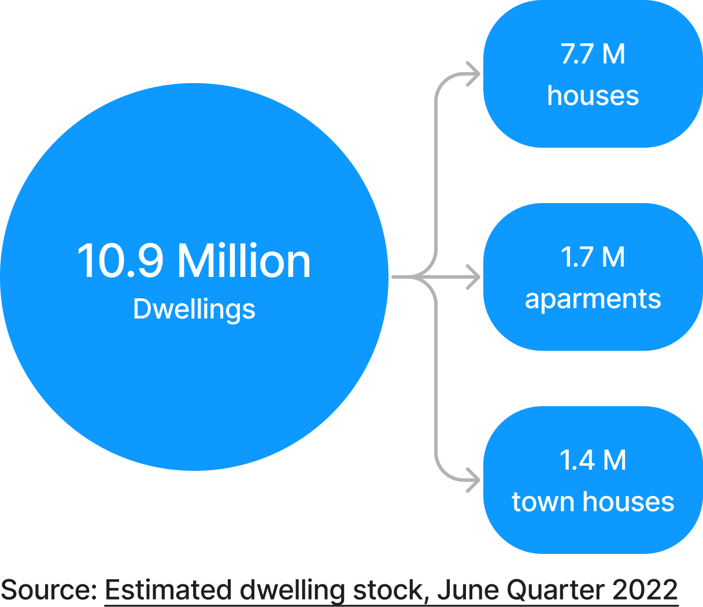
Market Share
User base
- Dwellings
owner occupied ?? – 66%
Average number of people per dwelling – 2.6
Usage frequency? Stickiness issue can be solved by expanding into various categories
10.9 M
7.2 M
- plumber
- electrician
- gardeners
- aircon
- outdoor landscaping
- indoor renovator
- Handyman
- Pest control
Cleaners
Security (cams etc.)
Car repair

Slide 9
Hypothesis

Slide 10
Business Model Canvas
Core Business activities
Tradie database
encourage usage and friends' referrals (feedback from the users ) to build the network effect for effective recommendations
effective recommendation (AI tuning)
Expanding the categories
Value Proposition
Users
Quick access to trusted recommendations
Reaching friends without hassling them
Data privacy – contact data not saved outside the phone
Tradies
Higher conversion due to trusted recommendation channel
Focus on the work, rather than expend effort on seeking ratings, which induces stress
Risks
phone book access
How to get our app trusted by users
data leakage
Privacy breach
Key resources
tradie info - internet bot (web page crawler/web scraping)
AI models – recommendation engine
mobile app and web portal developers
SME of category to write knowledge articles
Behavioural scientists \ data scientists
Data enrichers – tradie business info; business houses; council directory; ABN lookup
Cost Structure
Capex
IT hosting
App dev infra
Behavioural scientists
SME
Business registration and admin
Opex
IT opex
Category expansion – SME
Gamification – coffees
Marketing and ads
Revenue streams
- free and paid version
- curated ads (not sponsor tradie listings)
- one time app fee or annual app fees
Customer relationships
Acquisition
Word of mouth – friends circle
Communities
Startup hubs and networking
Mentors
Retention
Increase usage by exploring newer categories
Improve relationship status with the ability to thanks the friend; send hearts or flowers or thank you note….
Gamification – badges; higher level – credits (coffees, flyby points etc.)
Newsletters
Targeted Education\knowledge articles – people who bought this, also bought this new thing…
Channels
Mobile app
Portal
Customer segments
Users
Tradies
Partners
IT

Slide 11
Funding needs
- app development
- IT ops
- marketing
- Admin

Slide 12
Is there any similar alternatives available in other forms?
What research has been done in regards including citations
Why ratings are not reliable - Google is terrible at spotting fake reviews: and they're pretty obvious. Strange, jumbled names who leave a generic comment and positive review are clearly fake accounts. Often, similar accounts like these appear for the same company around the same time
Untrustworthy businesses buy fake customer reviews like there’s no tomorrow.
Implications of web scraping public domain data from websites like Yellow Pages

Slide 13
Competition
 | Model | Cons
Airtasker | People quote their price and providers bid | - People have no clue about pricing their job - non-licensed tradies; fake
HIPages | Listings portal | - Tradie oriented - sponsored
ServiceSeeking | Listings portal | - Tradie oriented - sponsored
Facebook, Insta | Lifestyle networking | - people don’t like to talk about their issues; it mainly about good life ☺
Google search | Search and Listings portal | - people must spend time searching - cannot rely on the reviews (known for false reviews and paid reviews)

Slide 14
Any existing solutions/apps

Slide 15
FAQs
What about have 3 plumber numbers? – ability to provide preference/sequencing

Slide 16
Encourage stories
Ask open ended questions
Get to specifics
Don't lead
Ask WHY
Short questions
Ask about past or present
Give Time to answer

Slide 17
Problem
Customer Segments
Unique value proposition – Single clear message that’s differentiate
Solution – Top 3 features
Unfair advantage - Can't be easily copied
Revenue stream – Life time value
MVP – Landing page, validation of the problem / solution

